Slide 1






Fragment orbital-based surface hopping (FOB-SH): Method, Implementation, Application
Jochen Blumberger
University College London
Department of Physics and Astronomy
Vista Seminar Series
22.10.2020

Slide 2

Content
FOB-SH: a tool for simulating electronic transport processes in truly nanoscale molecular materials
Application to charge transport in
organic crystals and the emergence
of large ``flickering” polarons
Tricks of the Trade: importance of decoherence correction, trivial crossing detection and all that

Slide 3
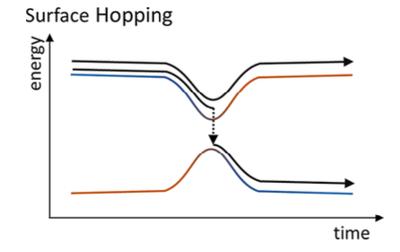
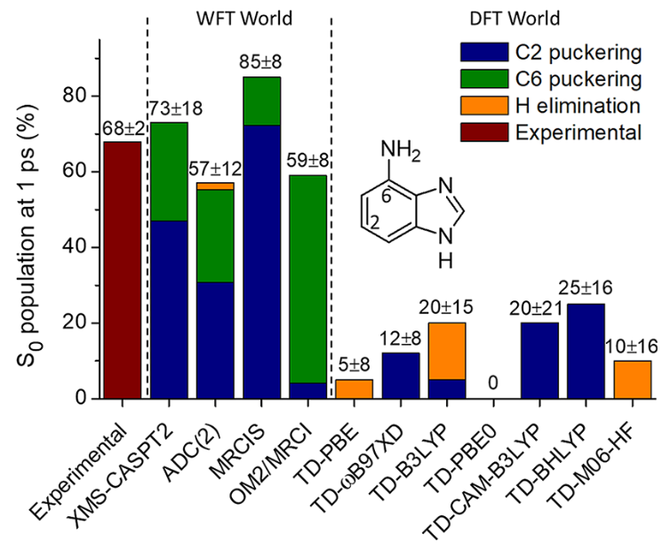
Workhorse for photochemistry
(Tully, J. Chem. Phys. 1990)
Crespo-Otero and Barbatti
Chem. Rev. 118, 7026 (2018)
But: ad-hoc/intuitive, no nuclear tunneling,….

Slide 4


Challenge 1: Ascending (another) Jacob’s ladder
.
.
.
Multiconfigurational time-dependent Hartree (Meyer,…)
(Classical limit of) Exact factorisation of molecular wavefunction (Gross,…)
Ab-initio multiple spawning (Martinez,…)
Ring-polymer MD with non-adiabatic transitions (T. Miller,…)
Fewest switches surface hopping (Tully,…)
Ehrenfest dynamics (Ehrenfest)

Slide 5
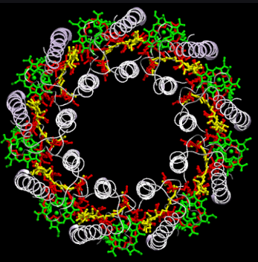
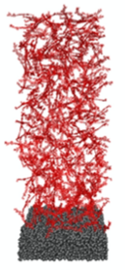
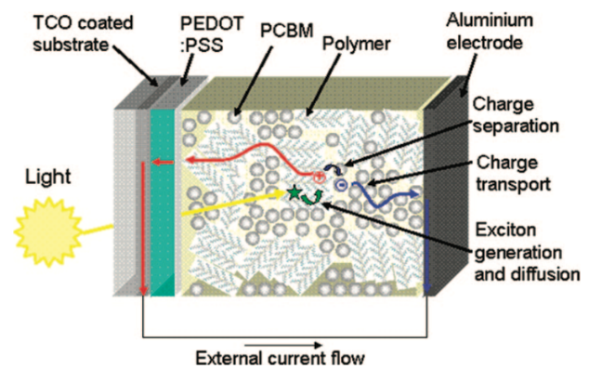
Challenge 2 (this talk): Going bigger
Non-adiabatic dynamics at the true nanoscale (> 5 nm):
Light
harvesting
Energy transfer
Organic
Transistors
+
Charge transport
Exciton dissociation
to charges, recombination
Solar Cells
Electronic processes can be strongly delocalized in space (no QM/MM)
and non-periodic (no periodic supercells)

Slide 6
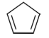

Molecular → True Nanoscale: How?
100,000 atoms
??
TDDFT
SH
100 atoms
10 femtosecond/day
1 picoseconds/day

Slide 7
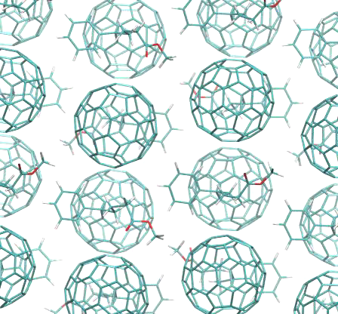
Molecular → True Nanoscale
Fragment Orbital-Based
Surface Hopping
Martinez, Burghardt,
Akimov, Elstner,.....
100,000 atoms
FOB
SH
Fragment and
Conquer
J. Spencer, F. Gajdos, JB, JCP 145, 064102, 2016.
A. Carof, S. Giannini, JB, JCP 147, 214113, 2017.
S. Giannini, A. Carof, JB JPCL, 9, 3116, 2018.
A. Carof et al. PCCP 21, 26368, 2019.
S. Giannini et al. Nat. Comm. 10, 3843, 2019.
S. Giannini et al. Adv. Theor. Simul. 3, 2000093, 2020.
TDDFT
SH
100 atoms
10 femtosecond/day
1 picoseconds/day

Slide 8

FOB-SH implemented for:
Charge transport in molecular materials (this talk)
Exciton transport in molecular materials (upcoming VISTA talk by Samuele Giannini(?))
Exciton dissociation and charge recombination at nanoscale materials interfaces (in progress)

Slide 9
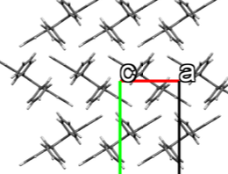
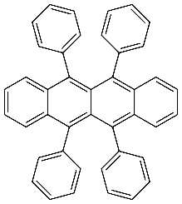
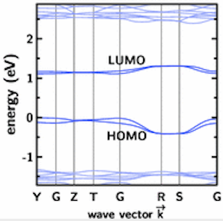
Charge transport in molecular materials
DFT band structure
rubrene
→ narrow bands

Slide 10
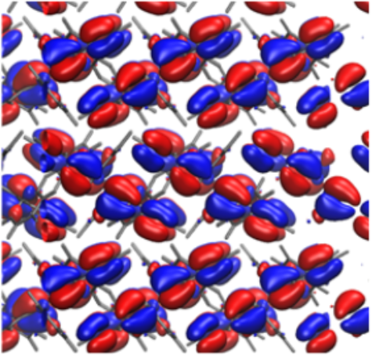
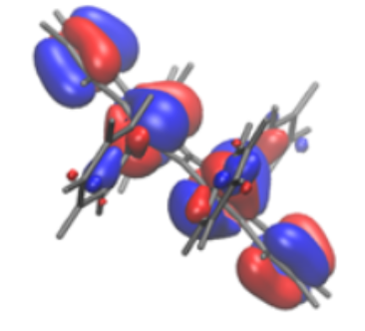
Charge transport in molecular materials
DFT band structure
Valence Band (VB)
rubrene
VB ≃ linear combinations
of HOMOs
→ narrow bands

Slide 11
Charge transport in molecular materials
DFT band structure
Valence Band (VB)
Hole Transport
in VB
rubrene
+
VB ≃ linear combinations
of HOMOs
k_{B}T
Non-adiabatic dynamics
of hole in valence band
→ narrow bands

Slide 12
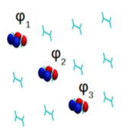

FOB-SH for charge transport
JCP 145, 064102 (2016), JCP 147, 214113 (2017), JPCL 9, 3116 (2018), PCCP 21, 26368 (2019)
electron hole
nuclei
State basis of HOMO orbitals
Classical nuclear dynamics
ϕ₁
state
1
ϕ₂
2
ith adiabatic electronic state
ϕ₃
3
.
.
Stochastic hopping from
surface E_{i} → E_{j} with
probability
Hole wavefunction:
Schrodinger equation for hole:
Antoine Carof

Slide 13
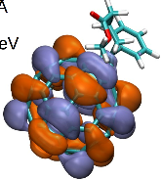
1. Fast calculation of Hole Hamiltonian
J. Spencer, F. Gajdos, JB, JCP 145, 064102, 2016.
Hole Hamiltonian (``Tight binding”):
force field
Analytic overlap
method (AOM)
1
4
7
I
I
I
ϕ₁
I
2
I
5
I
8
H =
ϕ₂
I
3
I
6
I
9
ϕ₃

Slide 14
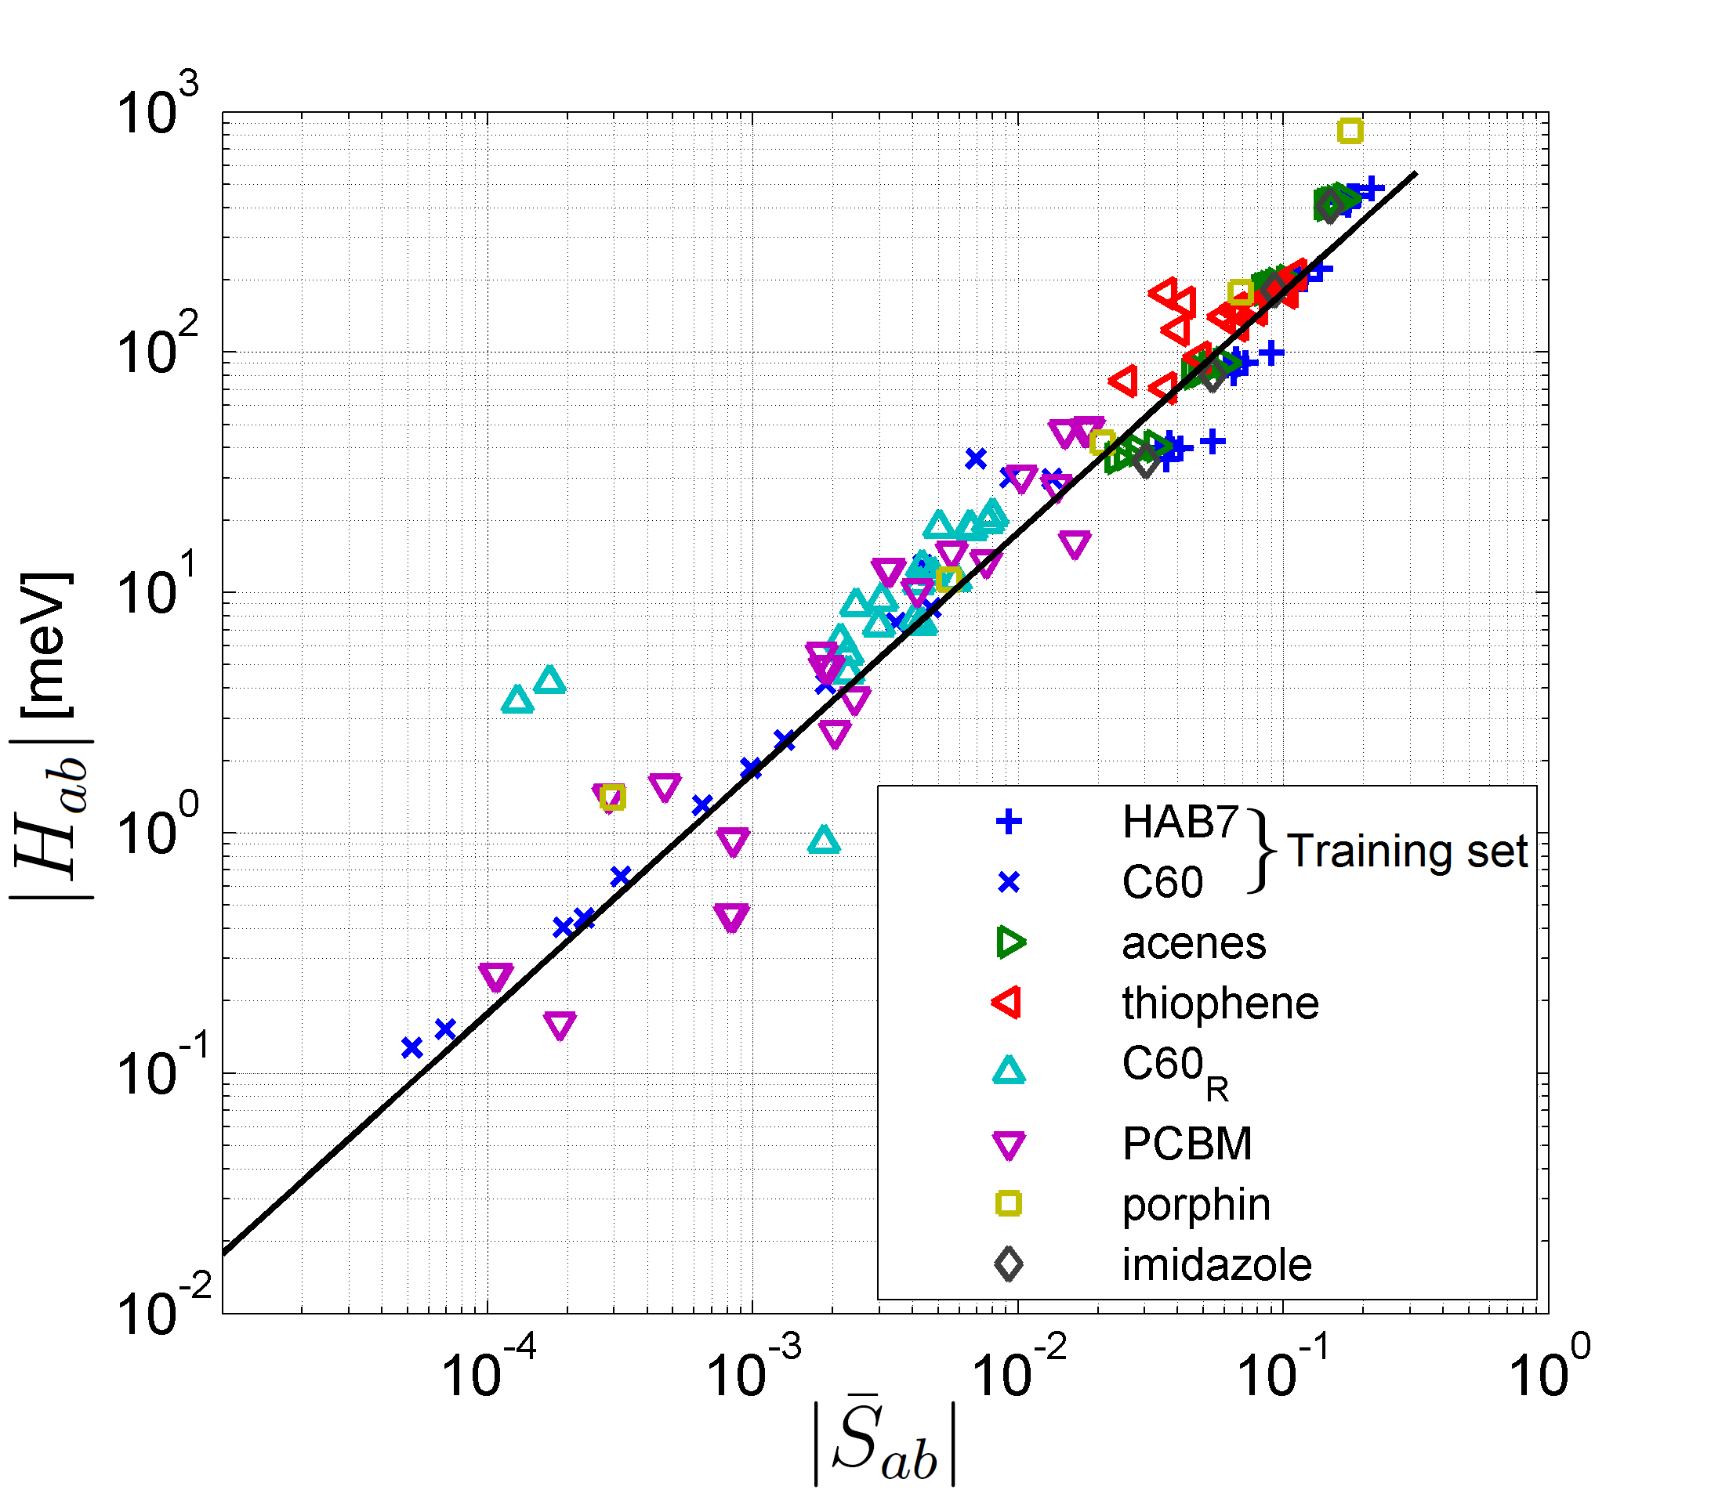
Ultrafast estimation of electronic couplings
F. Gajdos, JB et al. J. Chem. Theor. Comput. 10, 4653 (2014).
blue symbols
=
Training set
(black line)
other symbols
=
Test sets
mean error = factor 1.9
over 5 decades!

Slide 15
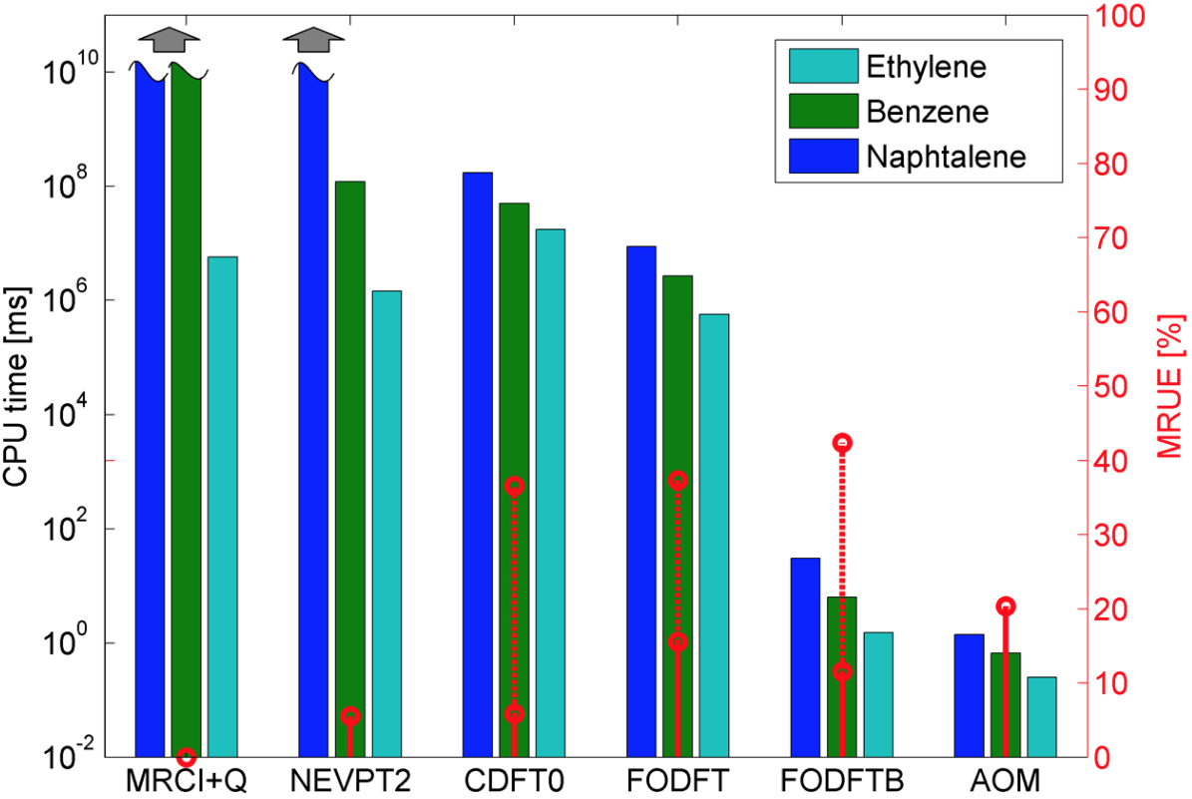
Speed-up of 6 orders of magnitude, 20% loss of accuracy
F. Gajdos, JB et al. J. Chem. Theor. Comput. 10, 4653 (2014).

Slide 16
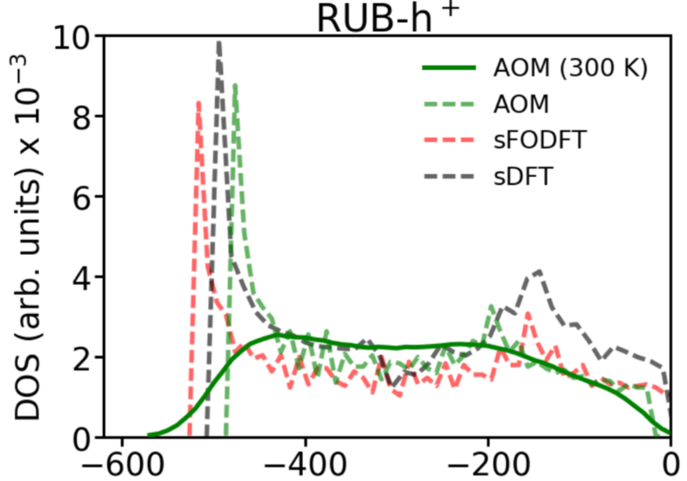
Density of states rubrene valence band
top of
valence band
Good agreement AOM vs sDFT for peak position
and band width (0.5 eV)

Slide 17

2. Fast calculation of nuclear gradients
J. Spencer, F. Gajdos, JB, JCP 145, 064102, 2016
A. Carof, S. Giannini, JB, JCP 147, 214113, 2017
nuclear force on
adiabatic PES i
NACV between PESs i,j
off-diagonal gradients in HOMO basis
(diagonal gradient from force field)
overlap gradients in HOMO basis
Antoine Carof
NACV in HOMO basis
(finite difference)

Slide 18
3. Making surface hopping work
Decoherence correction: damping of inactive states
using frozen Gaussian approximation
Detection of trivial crossing: (i) State tracking algorithm
(ii) Enforcing sum rule:
Removal of decoherence-correction induced artificial long-range CT
via projection of wavefunction in moving active region
Schwartz, Bittner, Prezhdo, Rossky,
JCP 104, 5942 (1996)
Giannini, Carof, JB JPCL (2018)
similar to Tretiak’s algorithm
Wang and Prezhdo,
JPCL 5, 713 (2014)
Giannini, Carof, JB
JPCL (2018)

Slide 19
Content
FOB-SH: a tool for simulating electronic transport processes in truly nanoscale molecular materials
Application to charge transport in organic crystals
and the emergence of large ``flickering” polarons
Tricks of the Trade: importance of decoherence correction, trivial crossing detection and all that

Slide 20

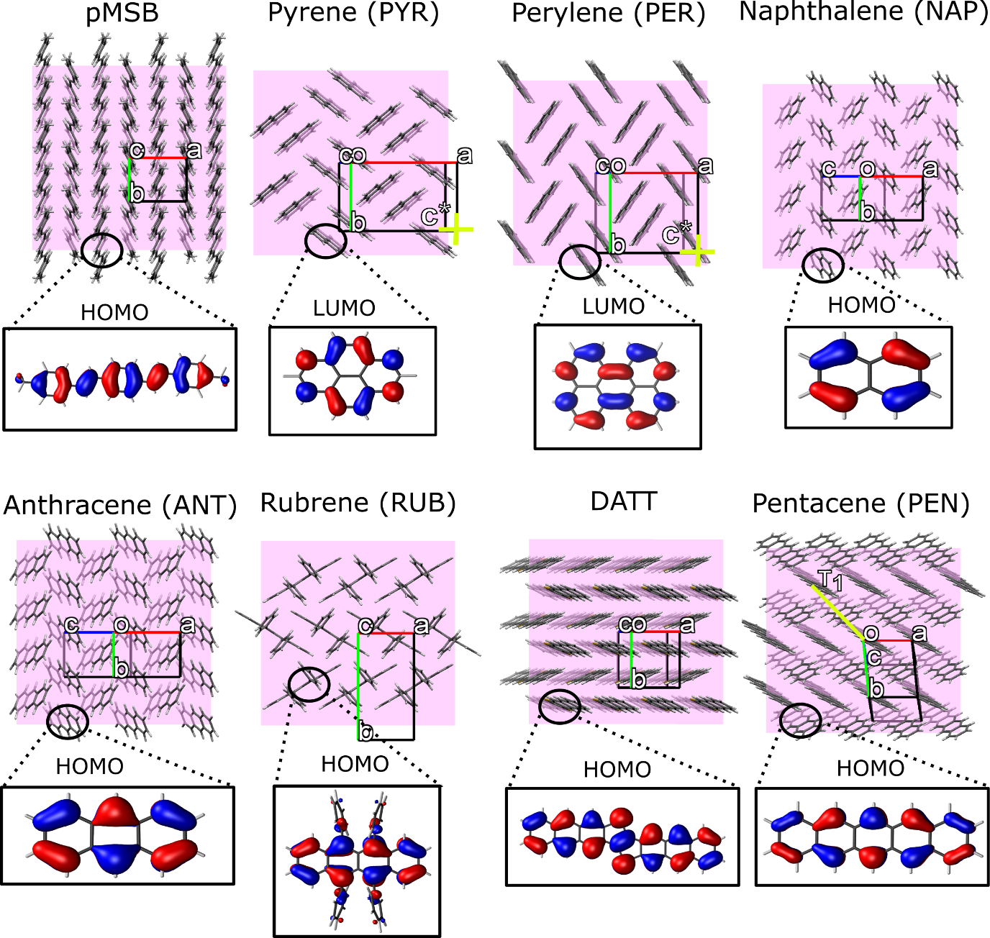
Organic Single Crystals
Samuele Giannini

Slide 21
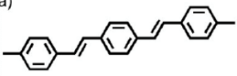
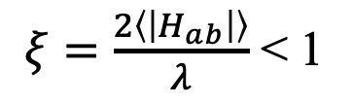
Hole transport in conductive plane at 300K
Giannini et al. Nature Comm. 10, 3843, 2019; Adv. Theor. Simul. 3, 2000093, 2020.
A
pMSB
small polaron hopping
$ξ=\frac{2\left\langle \left|H_{ab}\right|\right\rangle }{λ}$ < 1

Slide 22
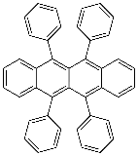
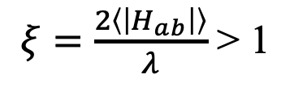
Hole transport in conductive plane at 300K
Giannini et al. Nature Comm. 10, 3843, 2019; Adv. Theor. Simul. 3, 2000093, 2020.
A
rubrene
pMSB
small polaron hopping
large (``flickering”) polaron
$ξ=\frac{2\left\langle \left|H_{ab}\right|\right\rangle }{λ}$ < 1
$ξ=\frac{2\left\langle \left|H_{ab}\right|\right\rangle }{λ}$ > 1

Slide 23
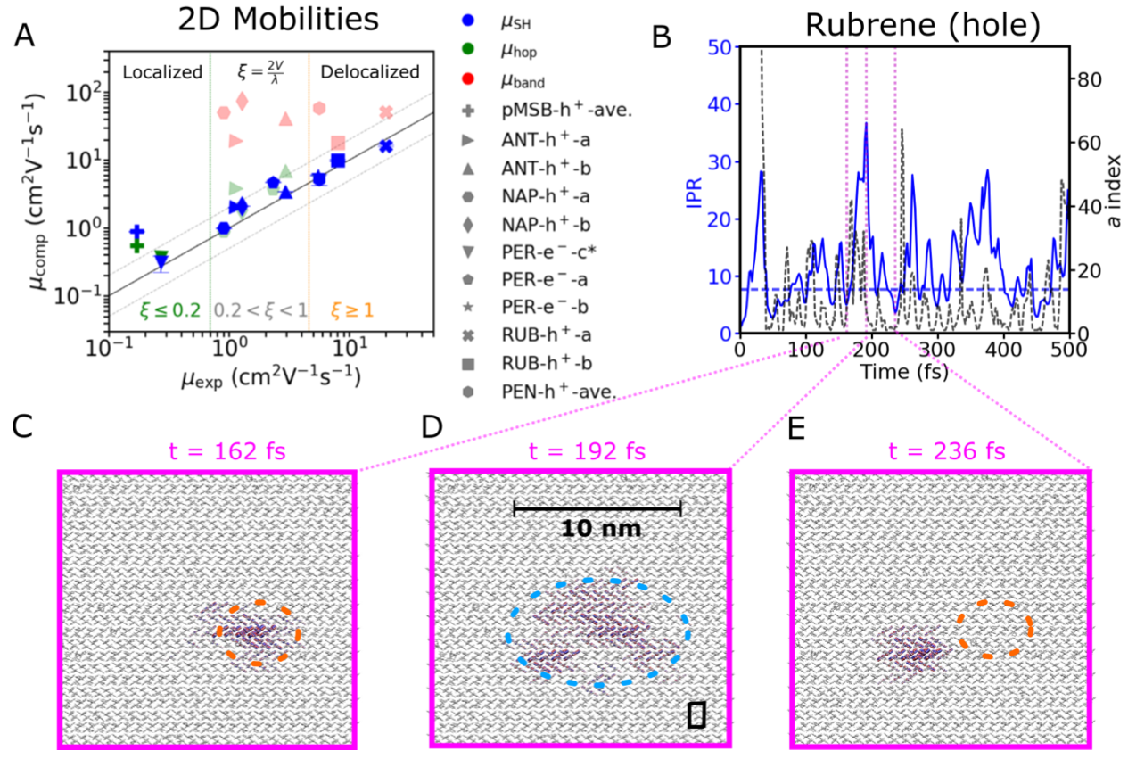
Transport Mechanism from FOB-SH
Giannini et al. Adv. Theor. Simul. 3, 2000093, 2020.
AAAA
AAAA
AAAA
AAAA
IPR = inverse participation ratio
(number of molecules over which
charge is delocalized)
a index = active state PES in FOB-SH
150
100
energy (meV)
50
0
AAAA
AAAA
AAAA
AAAA

Slide 24
Transport Mechanism from FOB-SH
Giannini et al. Adv. Theor. Simul. 3, 2000093, 2020.
AAAA
AAAA
AAAA
AAAA
IPR = inverse participation ratio
(number of molecules over which
charge is delocalized)
a index = active state PES in FOB-SH
150
100
energy (meV)
50
0
AAAA
AAAA
AAAA
AAAA

Slide 25
Transport Mechanism from FOB-SH
Giannini et al. Adv. Theor. Simul. 3, 2000093, 2020.
AAAA
AAAA
AAAA
AAAA
IPR = inverse participation ratio
(number of molecules over which
charge is delocalized)
a index = active state PES in FOB-SH
150
100
energy (meV)
50
0
AAAA
AAAA
AAAA
AAAA

Slide 26
Transport Mechanism from FOB-SH
Giannini et al. Adv. Theor. Simul. 3, 2000093, 2020.
AAAA
AAAA
AAAA
AAAA
IPR = inverse participation ratio
(number of molecules over which
charge is delocalized)
a index = active state PES in FOB-SH
150
100
energy (meV)
50
0

Slide 27
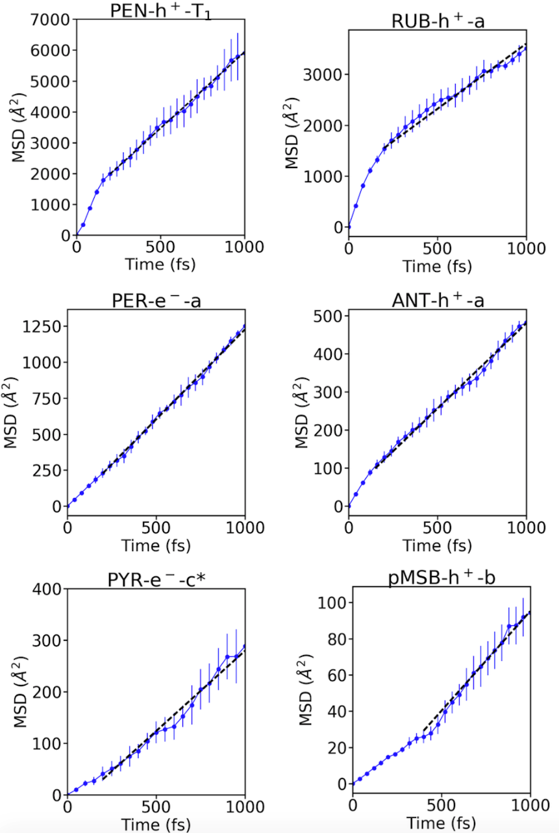
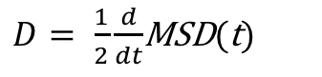
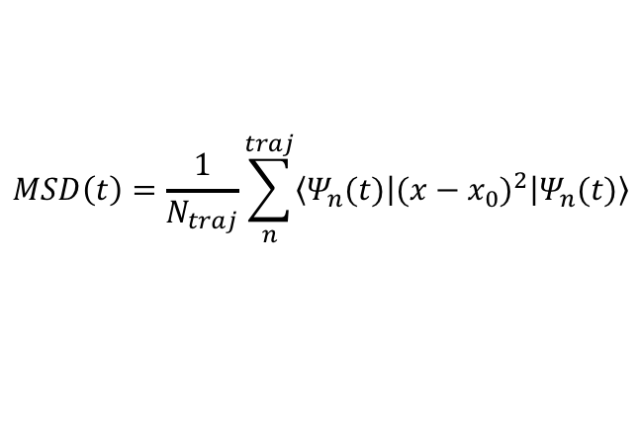
From trajectories to charge mobilities
Mean-Square Displacement
slope
$$MSD\left(t\right)=\frac{1}{N_{traj}}\sum_{n}^{traj}{\left\langle Ψ_{n}(t) | {(x−x_{0})}^{2} | Ψ_{n}(t)\right\rangle }$$
1000 traj
Diffusion coefficient
$D= \frac{1}{2}\frac{d}{dt}$MSD(t)
Charge mobility

Slide 28
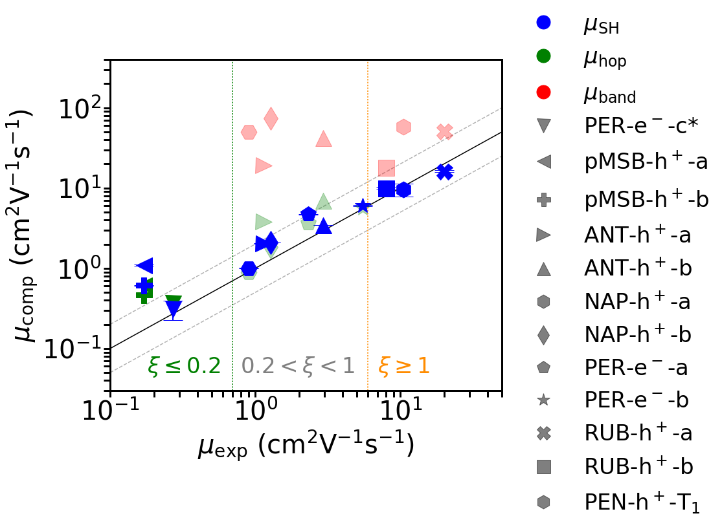
Charge mobility: FOB-SH vs Experiment
Giannini et al. Nature Comm. 10, 3843, 2019; Adv. Theor. Simul. 3, 2000093, 2020.
small
polaron
medium
polaron
large
polaron

Slide 29
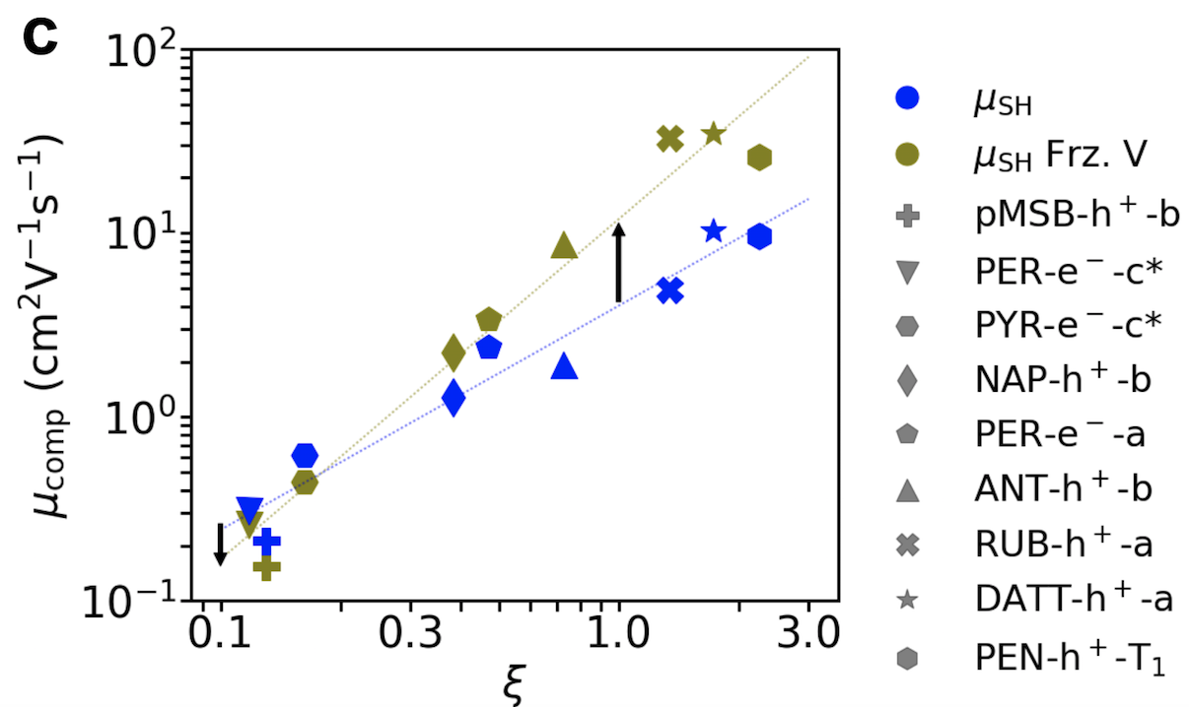
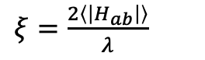
What limits charge mobility in organic crystals?
Thermal fluctuations of electronic coupling
Giannini et al. Nature Comm. 10, 3843, 2019.
A
couplings frozen
to mean value
couplings fluctuate
(as before)
$ξ=\frac{2\left\langle \left|H_{ab}\right|\right\rangle }{λ}$

Slide 30
Content
FOB-SH: a tool for simulating electronic transport processes in truly nanoscale molecular materials
Application to charge transport in organic crystals
and the emergence of large ``flickering” polarons
Tricks of the Trade: importance of decoherence correction, trivial crossing detection and all that

Slide 31
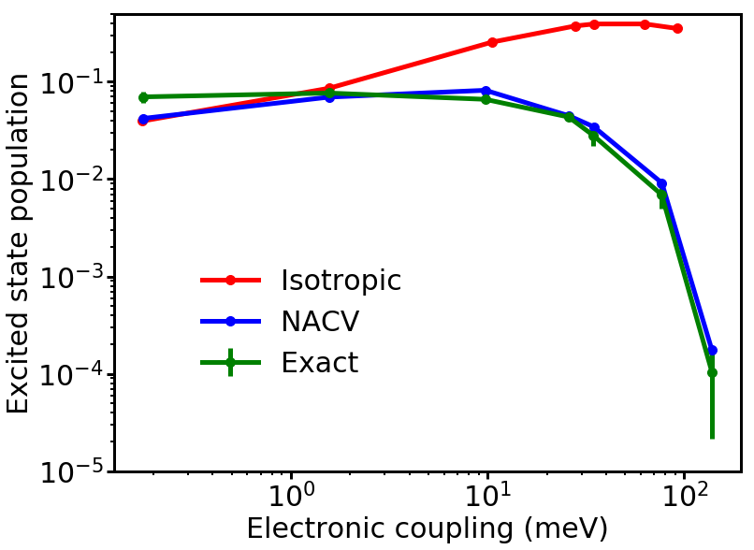
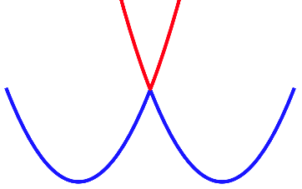
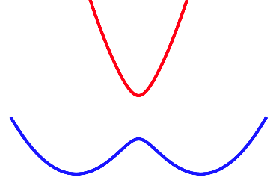
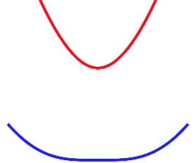
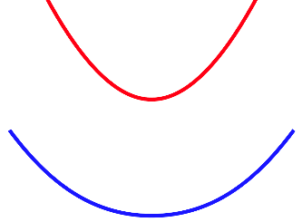
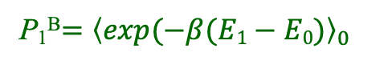
1. Energy criterion for hops: Kinetic energy || NACV → Detailed balance
JCP 147, 214113 (2017)
no frustrated
hops
Detailed balance:
P₁^{surf} = P₁^{B}
P₁^{surf}, full kinetic energy
P₁^{surf} = population of excited
state PES in FOB-SH
P₁^{surf}, kinetic energy || NACV
P₁^{B}, exact Boltzmann weight
P₁^{B}$={\left\langle exp⁡(−β(E1−E0)\right\rangle }_{0}$
2 H_{ab}

Slide 32
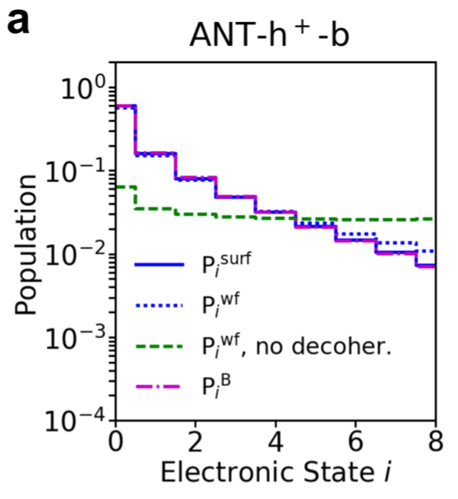
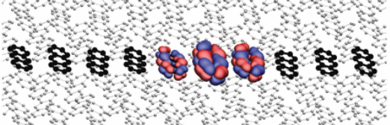
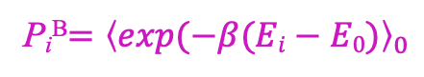
2a Decoherence correction → Internal consistency
Giannini et al. Nature Comm. 10, 3843, 2019.
Internal consistency
P_{i}^{surf} = P_{i}^{wf}
P_{i}^{surf} = population of adiabatic PES i
in FOB-SH
P_{i}^{wf} = population of electronic adiabatic
wavefunction i in FOB-SH
P_{i}^{B}$={\left\langle exp⁡(−β(Ei−E0)\right\rangle }_{0}$

Slide 33
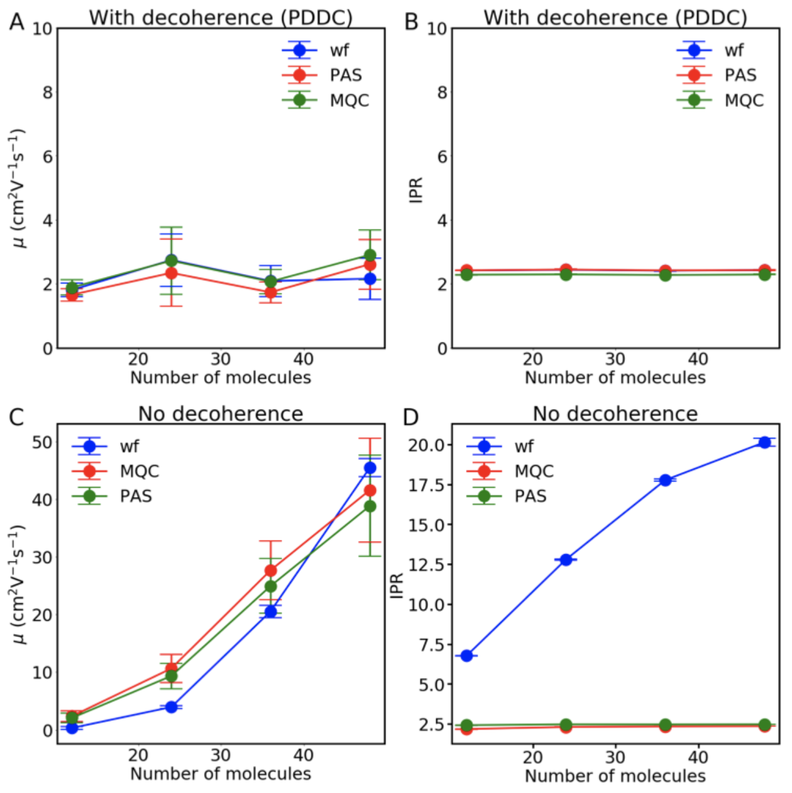
2b Decoherence correction → convergence of mobility
PCCP 21, 26368 (2019)
→ Mobilities diverge with system size without decoherence

Slide 34
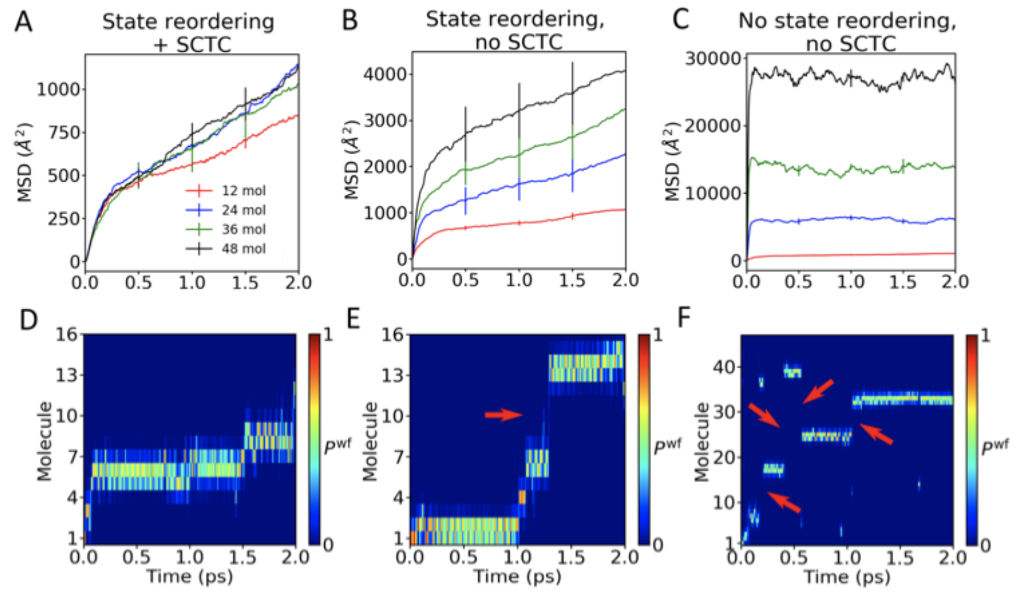
3. Spurious charge transfer correction (SCTC) → physical CT dynamics
AAAA
AAAAAA
AAAA
AAAA
AAAA

Slide 35
4. Detection of trivial crossings → physical CT dynamics
PCCP 21, 26368 (2019)

Slide 36
Summary
Developed a non-adiabatic MD method for real-time propagation of
charge carriers in ``soft” materials
Practical: -large systems (1000 sites ≙10⁵ valence electrons)
-convergence: 10³ trjs 1ps each in 1 day on 10³ cores
Predictive: Experimental mobilities well reproduced
New picture of charge carriers in ``soft” materials: not hopping, not band
Provides numerical benchmarks for new theories
e.g. transient localization theory, stochastic Liouville
Useful: Prediction of charge mobility in new materials

Slide 37
Outlook
Extending state space of electronic Hamiltonian in FOB-SH
Exciton transport (VISTA talk by Samuele Giannini (?))
Charge separation and recombination at n-p type interfaces (excitonic solar cells)
Exciton dissociation at n-p type interfaces
Beyond Surface Hopping
→ Classical limit of exact factorisation (Abedi, Gross, Agostini,…)
Ehrenfest + quantum momentum terms
Problem: Divergence of quantum momentum in Eq. S28 of Min et al. JPCL 2017
Surface Hopping with Quantum Nuclei/RPMD (Tully, Shushkov, Miller,…)
Problem: Many beads but only one electronic SE. Expensive.

Slide 38
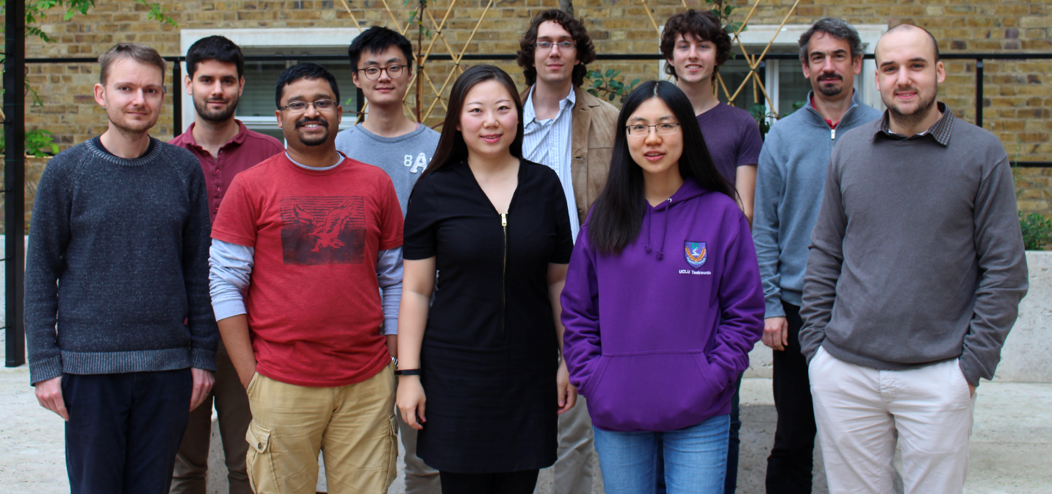

Acknowledgements
Antoine Carof
Soumya Ghosh
Matt Ellis
Samuele Giannini

Slide 39
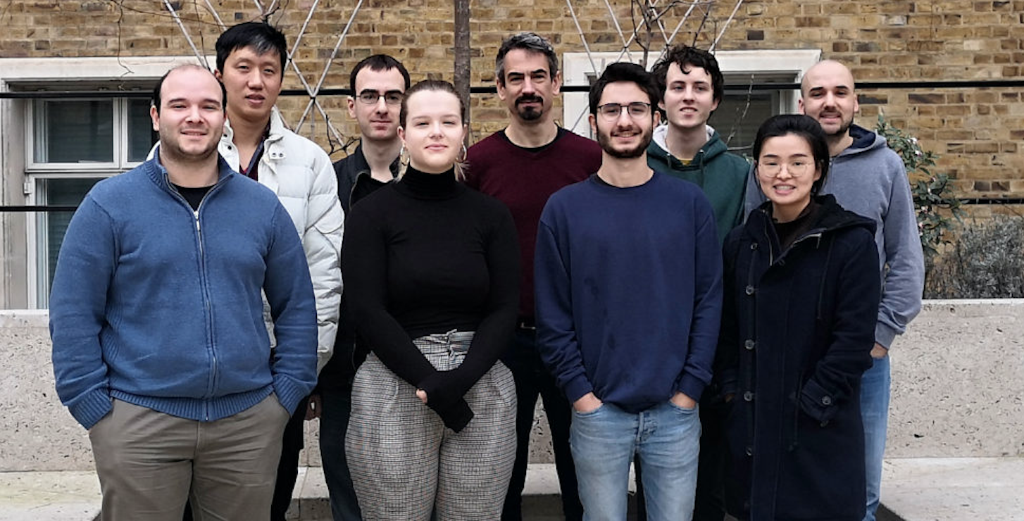
Acknowledgements
Orestis Ziogos
Wei-Tao Peng
Jan Elsner

Slide 40
23-25 June 2021
Face-to-face,
Virtual or
Hybrid

Slide 41


Slide 42
Fragment orbital-based surface hopping (FOB-SH)
2 major approximations:
1. Exact electron-nuclear quantum dynamics replaced by
mixed quantum-classical dynamics
2. Time-dependent multi-determinantal electronic wavefunction replaced by
a 1-particle wavefunction describing the excess electron or hole
NO explicit core and valence electrons.
Implicitly included by parametrization of electronic Hamiltonian.

Slide 43
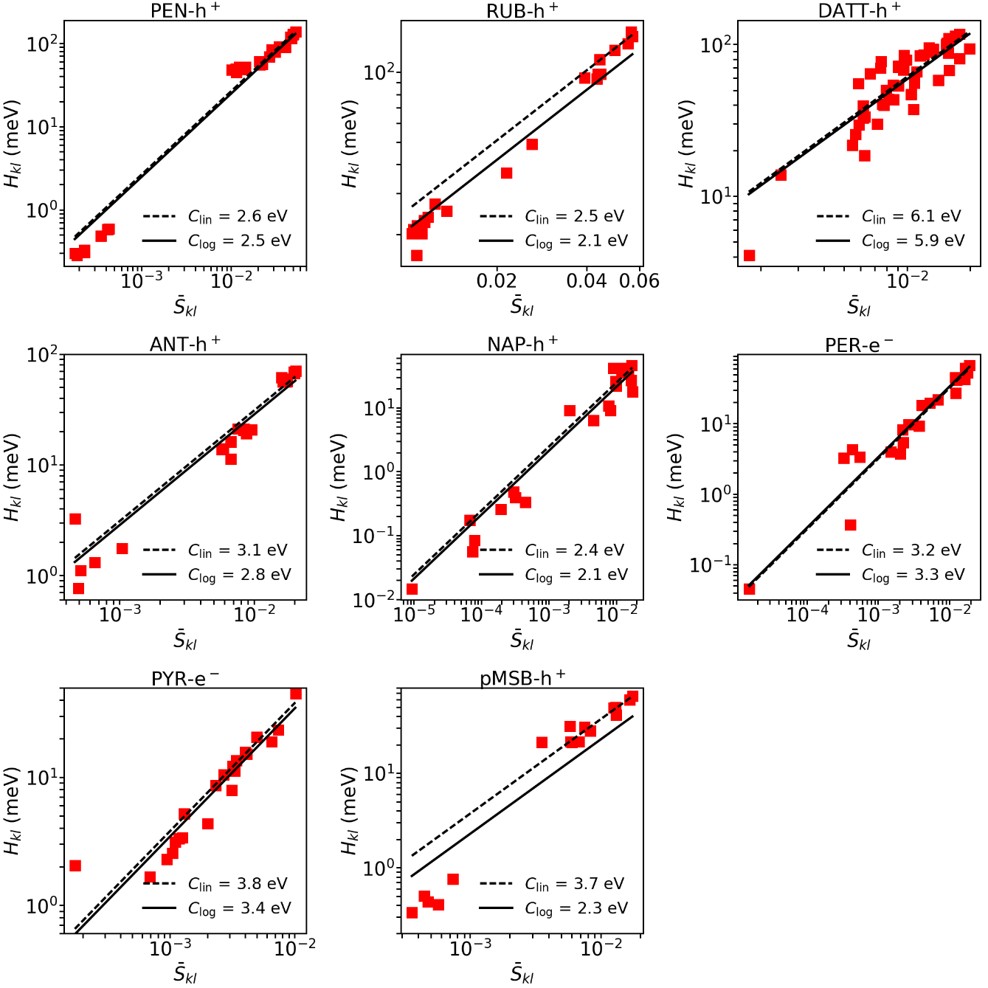
Analytic Overlap Method (AOM) for electronic couplings H_{kl} (as published)

Slide 44
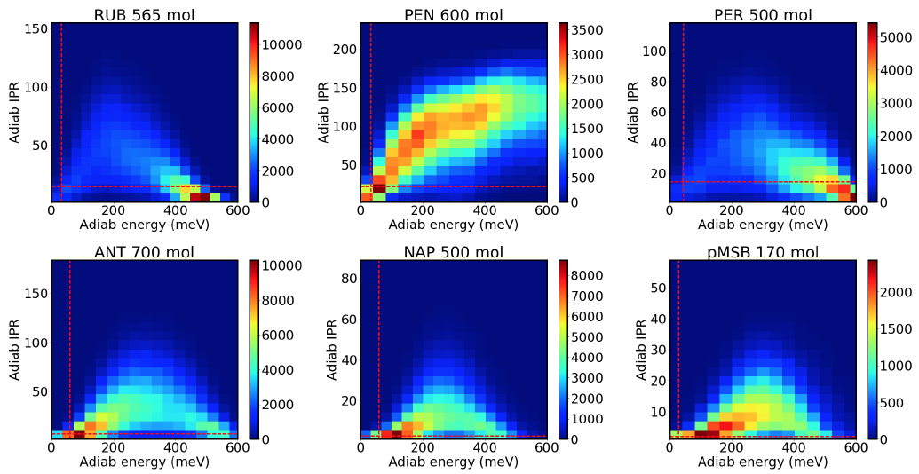
Density of states and IPR (new data)

Slide 45
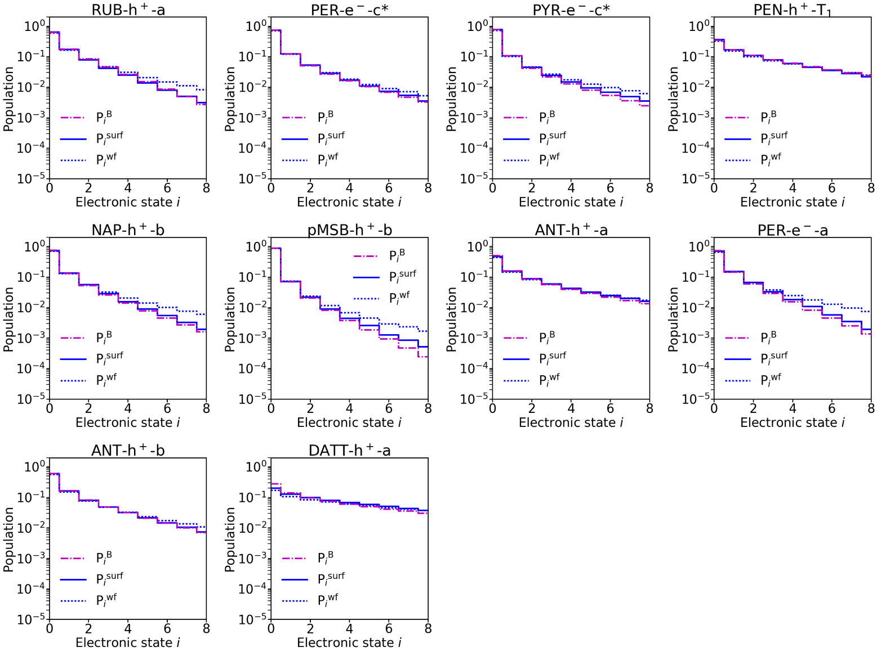
Detailed balance and internal consistency
Rescale velocities || NACV → detailed balance
Decoherence correction → internal consistency

Slide 46
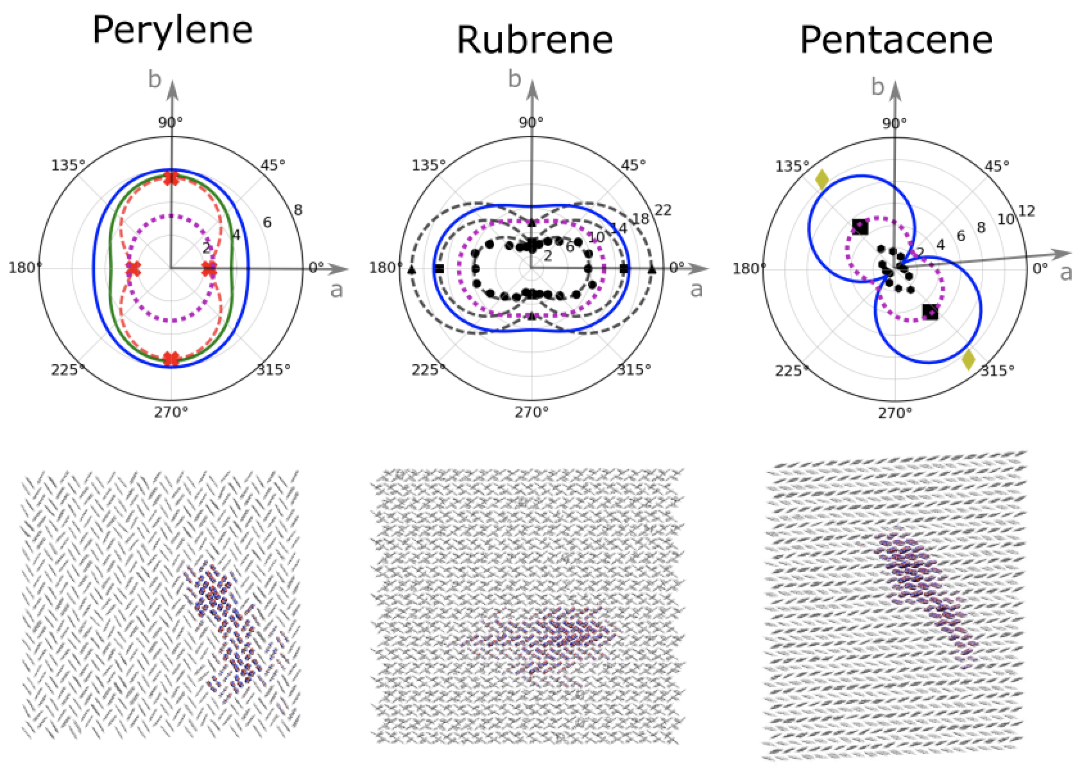
Summary: Nature of holes in OS crystals
Giannini et al. Nature Comm. 10, 3843, 2019.

Slide 47
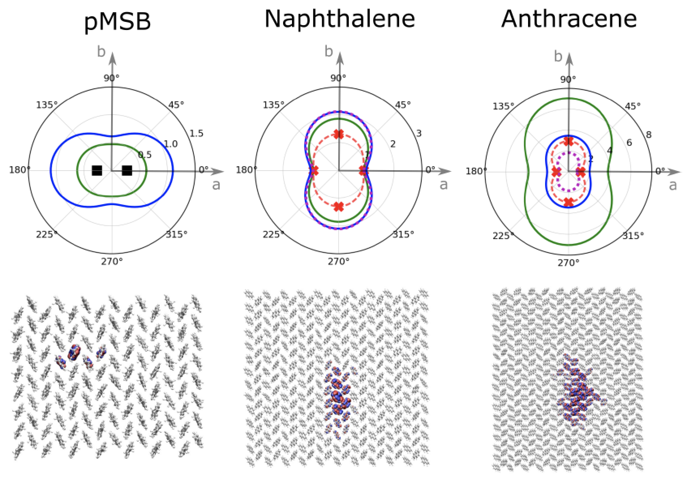
Summary: Nature of holes in OS crystals
Giannini et al. Nature Comm. 10, 3843, 2019.

Slide 48
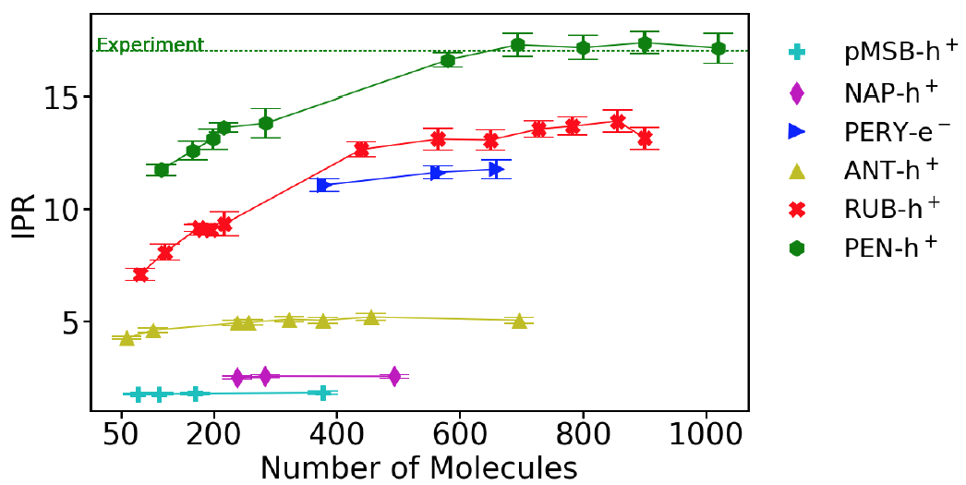
Convergence IPR wrt system size (new data)
(polaron size)
(system size)

Slide 49
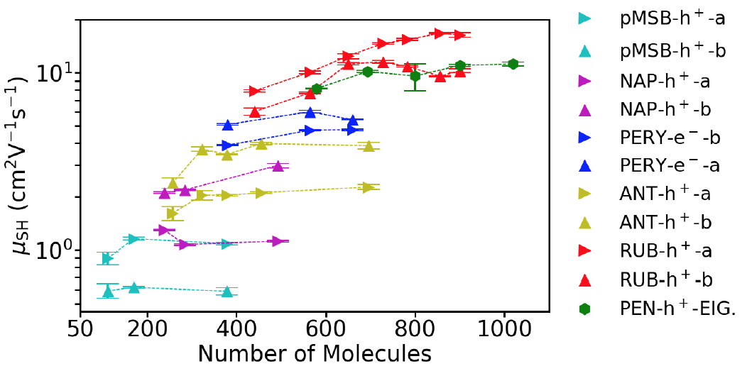
Convergence 2D mobility wrt system size

Slide 50
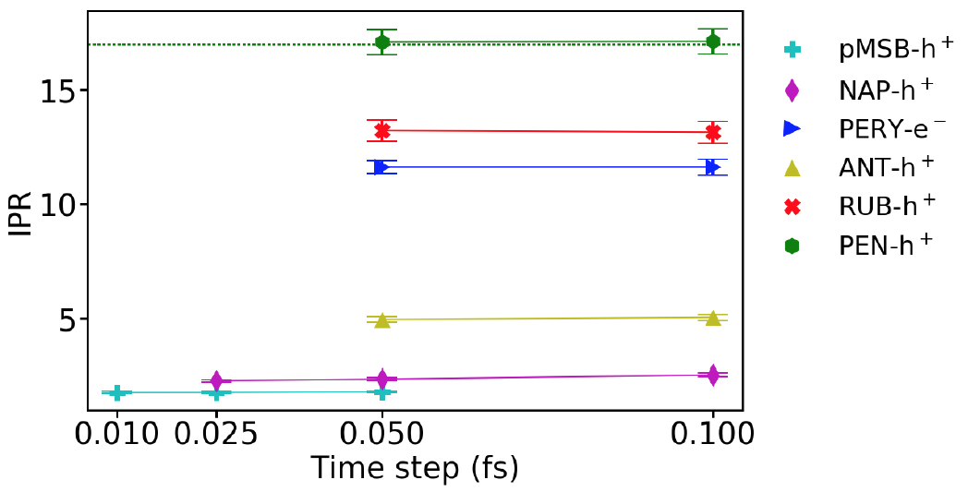
Convergence IPR wrt time step (new data)
(polaron size)

Slide 51

Convergence 2D mobility wrt time step (new data)

Slide 52

Mobility correlates well with polaron size (as published)
Giannini et al. Nature Comm. 10, 3843, 2019.

